Slide 1

EU Superstore Sales Analysis
By:
Sreepriya Meerel

Slide 2

Project Scope:
To develop a story and an interactive dashboard using Tableau for a superstore sales dataset
Goal: To gain valuable insights into sales trends and aid in enhancing sales performance.

Slide 3
Obtain and Load the Dataset:
Acquired the superstore sales dataset in a compatible format( Excel).
Imported the dataset in Tableau Public account

Slide 4

Transform and Clean the Data:
Removed duplicates
Handled missing or null values
Created calculated fields (e.g., Total sales, Days to ship etc.)

Slide 5

Create Visualizations:
The appropriate visualization types was chosen based on the dataset and analysis goals (e.g., bar charts, line charts, pie charts, etc.).
Visualizations were created by dragging and dropping fields from the dataset tables.
Legends were added.

Slide 6

Arrange & Format the Visualizations:
Arranged and resized the visualizations to create a visually appealing layout.
Created slicers and filters to allow users to interact with the data dynamically.
Adjusted formatting options like colors, fonts, titles, and backgrounds to match your desired aesthetic.
Applied a theme to maintain a consistent look and feel across the dashboard.

Slide 7
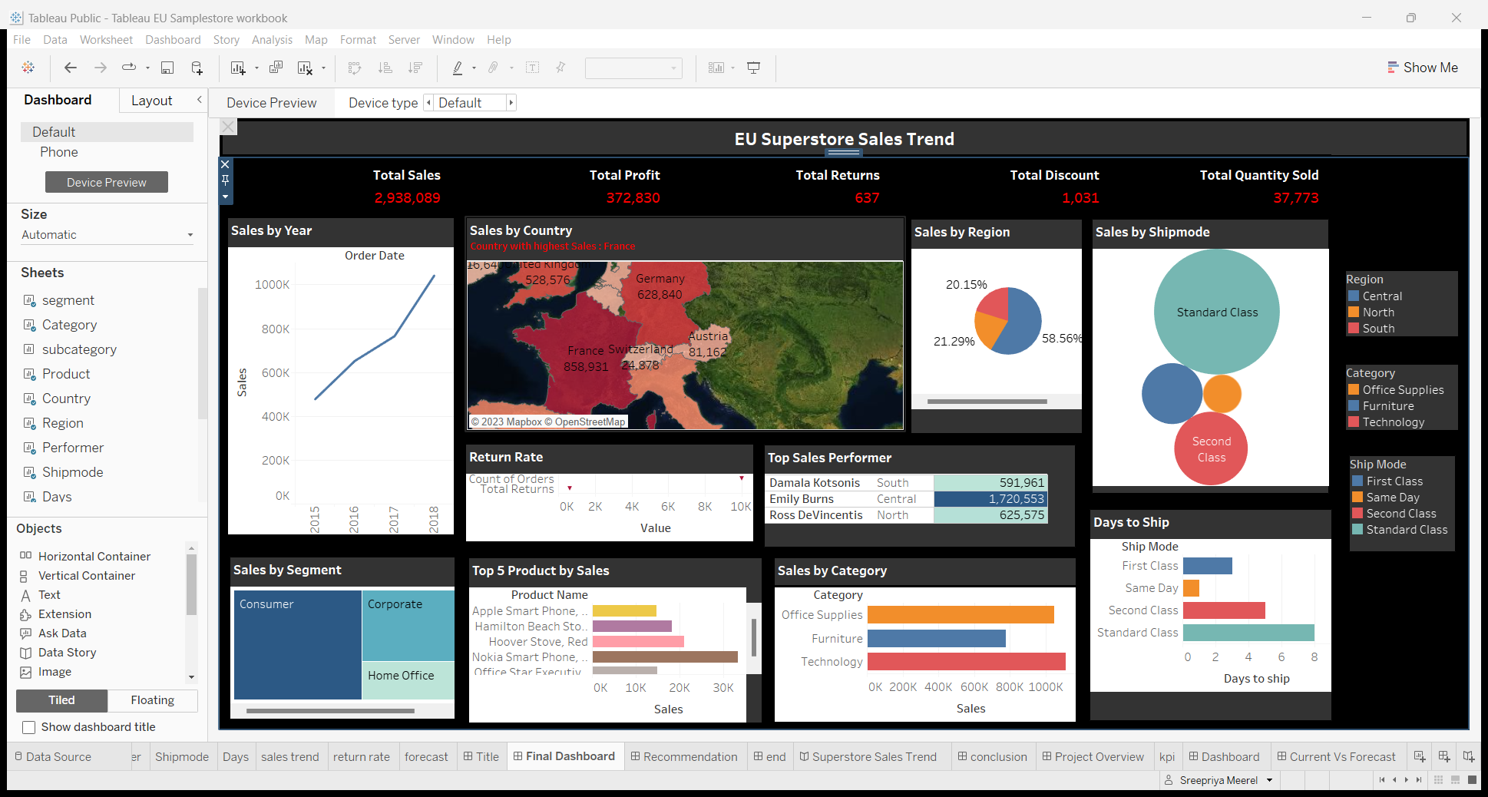
SALES DASHBOARD CREATED USING TABLEAU

Slide 8

Conclusion:
Sales exhibit a consistent uptrend from 2015 to 2018.
The Technology Category stands out with the highest sales.
The Central region remarkably contributes to a major share of sales, accounting for 58.5%.
Emily Burns, leading the Central region, demonstrates exceptional performance.
The French market appears promising for the store's products.
Standard shipping is the preferred choice for most consumers, despite an average delay period of 7 days.
In terms of Office Supplies, although there is a slightly higher shipping delay, this category offers substantial discounts.

Slide 9
Recommendations:
Enhanced Marketing Strategies
Optimize Pricing Strategy
Inventory Management
Collaborate with Suppliers to improved profit margins.
Collect Customer Feedback and survey
Community Involvement to increase brand awareness
Improve Customer Service.
Regular Sales Training and Incentives to staff.
Expand Product Range based on market demands and trends.
Utilize Cross-Selling

Slide 10

Thank you!

